Slide 1
Unit – V Protocols and Tools

Slide 2
Indirect TCP

Slide 3
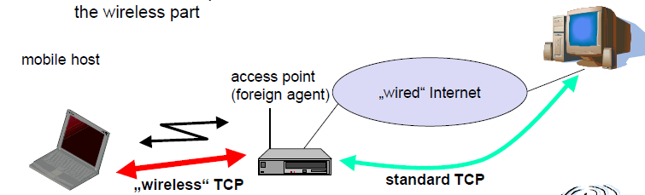
Indirect TCP
Indirect TCP or I-TCP segments the connection
no changes to the TCP protocol for hosts connected to the wired Internet, millions of computers use (variants of) this protocol
optimized TCP protocol for mobile hosts
splitting of the TCP connection at, e.g., the foreign agent into 2 TCP connections, no real end-to-end connection any longer
hosts in the fixed part of the net do not notice the characteristics of the wireless part

Slide 4
Indirect TCP (Contd…)
Advantages
No changes in the fixed network necessary, no changes for the hosts (TCP protocol) necessary, all current optimizations to TCP still work
Wireless link transmission errors isolated from those in fixed network
simple to control, mobile TCP is used only for one hop between, e.g., a foreign agent and mobile host
therefore, a very fast retransmission of packets is possible, the short delay on the mobile hop is known
Disadvantages
loss of end-to-end semantics, an acknowledgement to a sender does
now not any longer mean that a receiver really got a packet, foreign agents might crash
higher latency possible due to buffering of data within the foreign agent and forwarding to a new foreign agent

Slide 5
Snooping TCP

Slide 6
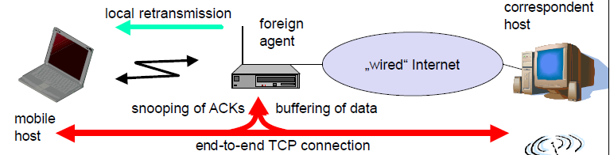
Snooping TCP
Transparent“ extension of TCP within the foreign agent
buffering of packets sent to the mobile host
lost packets on the wireless link (both directions!) will be retransmitted immediately by the mobile host or foreign agent, respectively (so called “local” retransmission)
the foreign agent therefore “snoops” the packet flow and recognizes acknowledgements in both directions, it also filters ACKs
changes of TCP only within the foreign agent

Slide 7
Snooping TCP (Contd…)
Data transfer to the mobile host
FA buffers data until it receives ACK of the MH, FA detects packet loss via duplicated ACKs or time-out
fast retransmission possible, transparent for the fixed network
Data transfer from the mobile host
FA detects packet loss on the wireless link via sequence numbers, FA answers directly with a NACK to the MH
MH can now retransmit data with only a very short delay
Integration with MAC layer
MAC layer often has similar mechanisms to those of TCP
thus, the MAC layer can already detect duplicated packets due to retransmissions and discard them
Problems
snooping TCP does not isolate the wireless link as good as I-TCP
snooping might be tough if packets are encrypted

Slide 8
Mobile TCP

Slide 9
Mobile TCP
Special handling of lengthy and/or frequent disconnections
M-TCP splits as I-TCP does
unmodified TCP fixed network to supervisory host (SH)
optimized TCP SH to MH
Supervisory host
no caching, no retransmission
monitors all packets, if disconnection detected
set sender window size to 0
sender automatically goes into persistent mode
old or new SH reopen the window
Advantages
maintains semantics, supports disconnection, no buffer forwarding
Disadvantages
loss on wireless link propagated into fixed network q adapted TCP on wireless link

Slide 10
Fast retransmit/fast recovery

Slide 11
Fast retransmit/fast recovery
Change of foreign agent often results in packet loss
TCP reacts with slow-start although there is no congestion
Forced fast retransmit
as soon as the mobile host has registered with a new foreign agent, the MH sends duplicated acknowledgements on purpose
this forces the fast retransmit mode at the communication partners
additionally, the TCP on the MH is forced to continue sending with the actual window size and not to go into slow-start after registration
Advantage
simple changes result in significant higher performance
Disadvantage
Cooperation required between IP and TCP, no transparent approach

Slide 12
Transmission/time-out freezing

Slide 13
Transmission/time-out freezing
Mobile hosts can be disconnected for a longer time
no packet exchange possible, e.g., in a tunnel, disconnection due to overloaded cells or mux. with higher priority traffic
TCP disconnects after time-out completely
TCP freezing
MAC layer is often able to detect interruption in advance
MAC can inform TCP layer of upcoming loss of connection
TCP stops sending, but does now not assume a congested link
MAC layer signals again if reconnected
Advantage
scheme is independent of data
Disadvantage
TCP on mobile host has to be changed, mechanism depends on MAC layer

Slide 14
Selective retransmission

Slide 15
Selective retransmission
TCP acknowledgements are often cumulative
ACK n acknowledges correct and in-sequence receipt of packets up to n
if single packets are missing quite often a whole packet sequence beginning at the gap has to be retransmitted (go-back-n), thus wasting bandwidth
Selective retransmission as one solution
RFC2018 allows for acknowledgements of single packets, not only acknowledgements of in-sequence packet streams without gaps
sender can now retransmit only the missing packets
Advantage
much higher efficiency
Disadvantage
more complex software in a receiver, more buffer needed at the receiver

Slide 16
Transaction-oriented TCP

Slide 17
Transaction-oriented TCP
TCP phases
connection setup, data transmission, connection release
using 3-way-handshake needs 3 packets for setup and release, respectively
thus, even short messages need a minimum of 7 packets!
Transaction oriented TCP
RFC1644, T-TCP, describes a TCP version to avoid this overhead
connection setup, data transfer and connection release can be combined
thus, only 2 or 3 packets are needed
Advantage
efficiency
Disadvantage
requires changed TCP
mobility not longer transparent

Slide 18
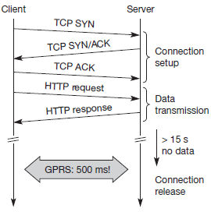
Transaction-oriented TCP (Contd…)
HTTP request can be transmitted the TCP connection has to be established. This already requires three messages.
This led to the development of a transaction-oriented TCP T/TCP can combine packets for connection establishment and connection release with user data packets.
This can reduce the number of packets down to two instead of seven

Slide 19
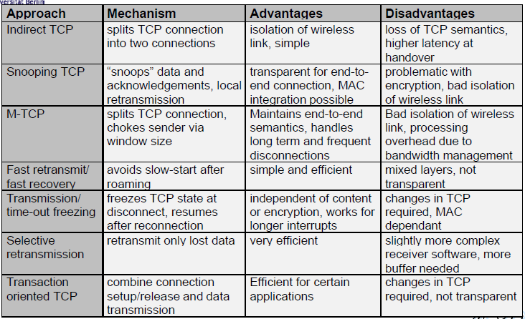
Comparison

Slide 20
Wireless Application Protocol

Slide 21
Wireless Application Protocol
Architecture
Wireless Datagram Protocol
Wireless Transport Layer Security
Wireless Transaction Protocol
Wireless Session Protocol
Wireless Application Environment
Wireless Markup Language
WMLScript

Slide 22
Videos
Wireless Application Protocol Overview

Slide 23
Introduction
Goals of WAP
deliver Internet content and enhanced services to mobile devices and users (mobile phones, PDAs)
independence from wireless network standards
open for everyone to participate, protocol specifications will be proposed to standardization bodies
applications should scale well beyond current transport media and device types and should also be applicable to future developments

Slide 24
Introduction (Contd…)
The solutions to wireless protocol must be
Interoperable, i.e., allowing terminals and software from different vendors to communicate with networks from different providers;
Scalable, i.e., protocols and services should scale with customer needs and number of customers;
Efficient, i.e., provision of QoS suited to the characteristics of the wireless and mobile networks;
Reliable, i.e., provision of a consistent and predictable platform for deploying services; and
Secure, i.e., preservation of the integrity of user data, protection of devices and services from security problems.

Slide 25
WAP Architecture

Slide 26
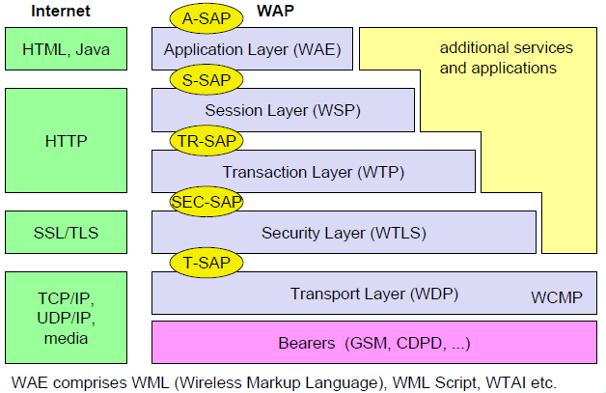
Architecture
Figure gives an overview of the WAP architecture, its protocols and components, and compares this architecture with the typical internet architecture when using the world wide web.

Slide 27
Architecture (Contd…)
The basis for transmission of data is formed by different bearer services.
WAP does not specify bearer services, but uses existing data services and will integrate further services.
No special interface has been specified between the bearer service and the next higher layer, the transport layer with its wireless datagram protocol (WDP) and the additional wireless control message protocol (WCMP), because the adaptation of these protocols are bearer-specific
The transport layer offers a bearer independent, consistent datagram-oriented service to the higher layers of the WAP architecture.
Communication is done transparently over one of the available bearer services.
The transport layer service access point (T-SAP) is the common interface to be used by higher layers independent of the underlying network.

Slide 28
Architecture (Contd…)
The next higher layer, the security layer with its wireless transport layer security protocol WTLS offers its service at the security SAP (SEC-SAP).
WTLS is based on the transport layer security (TLS, formerly SSL, secure sockets layer)
WTLS has been optimized for use in wireless networks with narrow-band channels.
It can offer data integrity, privacy, authentication, and (some) denial-of-service protection.

Slide 29
Architecture (Contd…)
The WAP transaction layer with its wireless transaction protocol (WTP) offers a lightweight transaction service at the transaction SAP (TR-SAP).
This service efficiently provides reliable or unreliable requests and asynchronous transactions
Tightly coupled to this layer is the next higher layer, if used for connection-oriented service
The session layer with the wireless session protocol (WSP) currently offers two services at the session-SAP (S-SAP), one connection-oriented and one connectionless if used directly on top of WDP.
A special service for browsing the web (WSP/B) has been defined that offers HTTP/1.1 functionality, long-lived session state, session suspend and resume, session migration and other features needed for wireless mobile access to the web.

Slide 30
Architecture (Contd…)
Finally the application layer with the wireless application environment (WAE) offers a framework for the integration of different www and mobile telephony applications.
It offers many protocols and services with special service access points
The main issues here are scripting languages, special markup languages, interfaces to telephony applications, and many content formats adapted to the special requirements of small, handheld, wireless devices.

Slide 31
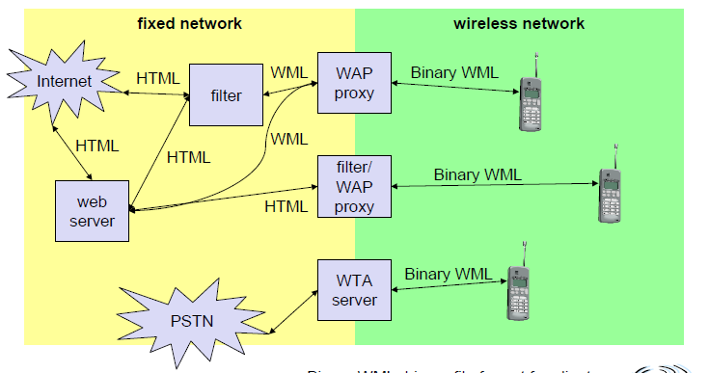
WAP Network Elements

Slide 32
Wireless Datagram Protocol

Slide 33
Wireless datagram protocol
The wireless datagram protocol (WDP) operates on top of many different bearer services capable of carrying data.
At the T-SAP WDP offers a consistent datagram transport service independent of the underlying bearer
To offer this consistent service, the adaptation needed in the transport layer can differ depending on the services of the bearer.
The closer the bearer service is to IP, the smaller the adaptation can be. If the bearer already offers IP services, UDP is used as WDP.
WDP offers more or less the same services as UDP.

Slide 34
Wireless datagram protocol (Contd…)
WDP offers source and destination port numbers used for multiplexing and demultiplexing of data respectively.
The service primitive to send a datagram is TDUnitdata.req with the destination address (DA), destination port (DP), Source address (SA), source port (SP), and user data (UD) as mandatory parameters
Destination and source address are unique addresses for the receiver and sender of the user data.
These could be MSISDNs (i.e., a telephone number), IP addresses, or any other unique identifiers.
The T-DUnitdata.ind service primitive indicates the reception of data.
Here destination address and port are only optional parameters.

Slide 35
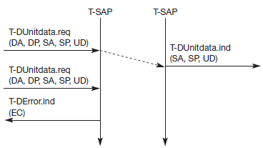
Wireless datagram protocol (Contd…)
WDP service primitives
If a higher layer requests a service the WDP cannot fulfill, this error is indicated with the T-DError.ind service primitive
An error code (EC) is returned indicating the reason for the error to the higher layer.

Slide 36
Wireless datagram protocol (Contd…)
If any errors happen when WDP datagrams are sent from one WDP entity to another the wireless control message protocol (WCMP) provides error handling mechanisms for WDP
WCMP contains control messages that resemble the internet control message protocol (ICMP)
Typical WCMP messages are
destination unreachable (route, port, address unreachable),
parameter problem (errors in the packet header),
message too big, reassembly failure, or echo request/reply.

Slide 37
Wireless Transport Layer Security

Slide 38
Wireless transport layer security
If requested by an application, a security service, the wireless transport layer security (WTLS), can be integrated into the WAP architecture on top of WDP
WTLS can provide different levels of security (for privacy, data integrity, and authentication) and has been optimized for low bandwidth, high-delay bearer networks.
WTLS takes into account the low processing power and very limited memory capacity of the mobile devices for cryptographic algorithms.
WTLS supports datagram and connection-oriented transport layer protocols.
WTLS took over many features and mechanisms from TLS

Slide 39
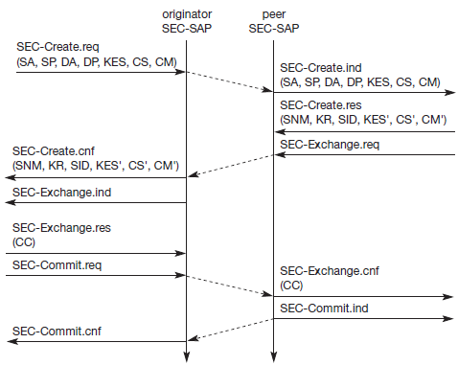
Wireless transport layer security (Contd…)
WTLS establishing a secure session

Slide 40
Wireless transport layer security (Contd…)
The first step is to initiate the session with the SEC-Create primitive.
Parameters are source address (SA), source port (SP) of the originator, destination address (DA), destination port (DP) of the peer.
The originator proposes a key exchange suite (KES), DH, a cipher suite (CS) and a compression method (CM).
The peer answers with parameters for the sequence number mode (SNM), the key refresh cycle (KR) (i.e., how often keys are refreshed within this secure session), the session identifier (SID) (which is unique with each peer), and the selected key exchange suite (KES’), cipher suite (CS’), compression method (CM’).
The peer also issues a SEC-Exchange primitive. This indicates that the peer wishes to perform public-key authentication with the client, i.e., the peer requests a client certificate (CC) from the originator.

Slide 41
Wireless transport layer security (Contd…)
The originator answers with its certificate and issues a SEC-Commit.req primitive.
This primitive indicates that the handshake is completed for the originator’s side and that the originator now wants to switch into the newly negotiated connection state.
The certificate is delivered to the peer side and the SEC-Commit is indicated.
The WTLS layer of the peer sends back a confirmation to the originator.
This concludes the full handshake for secure session setup.

Slide 42
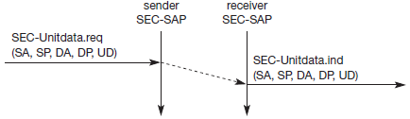
Wireless transport layer security (Contd…)
After setting up a secure connection between two peers, user data can be exchanged. This is done using the simple SEC-Unitdata primitive (figure)
SEC-Unitdata has exactly the same as T-DUnitdata on the WDP layer, namely it transfers a datagram b/t a sender & receiver.
This data transfer is still unreliable, but is now secure.
The higher layers simply use SEC-Unitdata instead of T-DUnitdata.
The parameters are the same here: source address (SA), source port (SP), destination address (DA), destination port (DP), and user data (UD).
Fig. WTLS datagram transfer

Slide 43
Wireless Transaction Protocol

Slide 44
Wireless transaction protocol
The wireless transaction protocol (WTP) is on top of either WDP or, if security is required, WTLS
WTP has been designed to run on very thin clients, such as mobile phones.
WTP offers several advantages to higher layers, including an improved reliability over datagram services, improved efficiency over connection-oriented services, and support for transaction-oriented services such as web browsing.
WTP offers many features to the higher layers. The basis is formed from three classes of transaction service as explained in the following paragraphs.
Class 0 provides unreliable message transfer without any result message.
Classes 1 and 2 provide reliable message transfer, class 1 without, class 2 with, exactly one reliable result message
WTP achieves reliability using duplicate removal, retransmission, acknowledgements and unique transaction identifiers.
No WTP-class requires any connection set-up or tear-down phase.
This avoids unnecessary overhead on the communication link.
WTP allows for asynchronous transactions, abort of transactions, concatenation of messages, and can report success or failure of reliable messages

Slide 45
Wireless transaction protocol (Contd…)
The three service primitives offered by WTP are
TR-Invoke to initiate a new transaction,
TR-Result to send back the result of a previously initiated transaction, and
TR-Abort to abort an existing transaction.
The PDUs exchanged between two WTP entities for normal transactions are
The invoke PDU, ack PDU, and result PDU.
A special feature of WTP is its ability to provide a user acknowledgement or, alternatively, an automatic acknowledgement by the WTP entity.

Slide 46
Wireless transaction protocol (Contd…) Class 0
Class 0 offers an unreliable transaction service without a result message.
The transaction is stateless and cannot be aborted.
The service is requested with the TR-Invoke.req primitive
Parameters are the source address (SA), source port (SP), destination address (DA), destination port (DP)
The WTP layer will transmit the user data (UD) transparently to its destination.
The class type C indicates here class 0.
Finally, the transaction handle H provides a simple index to uniquely identify the transaction
The WTP entity at the initiator sends an invoke PDU which the responder receives
The WTP entity at the responder then generates a TR-Invoke.ind primitive with the same parameters as on the initiator’s side, except for H’

Slide 47
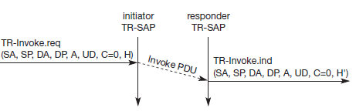
Wireless transaction protocol (Contd…) Class 0
In this class, the responder does not acknowledge the message and the initiator does not perform any retransmission.
WTP class 0 augments the transaction service with a simple datagram like service for occasional use by higher layers.
Basic transaction,
WTP class 0

Slide 48
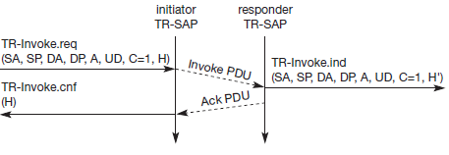
Wireless transaction protocol (Contd…) Class 1
Basic transaction,
WTP class 1, no user
acknowledgement
Class 1 offers a reliable transaction service but without a result message.
the initiator sends an invoke PDU after a TR-Invoke.req from a higher layer.
This time, class equals ‘1’, and no user acknowledgement has been selected as
The responder signals the incoming invoke PDU via the TR-Invoke.ind primitive to the higher layer and acknowledges automatically without user intervention.
The specification also allows the user on the responder’s side to acknowledge, but this acknowledgement is not required.
For the initiator the transaction ends with the reception of the acknowledgement.
The responder keeps the transaction state for some time to be able to retransmit the acknowledgement if it receives the same invoke PDU again indicating a loss of the acknowledgement.

Slide 49
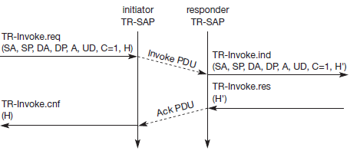
Wireless transaction protocol (Contd…) Class 1
Initiator’s side requests a user acknowledgement on the responder’s side, the sequence diagram looks like Figure
Now the WTP entity on the responder’s side does not send an acknowledgement automatically, but waits for the TR-Invoke.res service primitive from the user.
This service primitive must have the appropriate local handle H’ for identification of the right transaction.
The WTP entity can now send the ack PDU.
Basic transaction,
WTP class 1, with user
acknowledgement

Slide 50
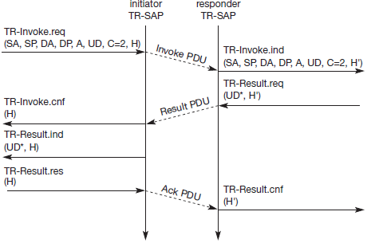
Wireless transaction protocol (Contd…) Class 2
Class 2 transaction service provides the classic reliable request/response transaction
Figure shows the basic transaction of class 2 without-user acknowledgement.
Basic transaction,
WTP class 2, with no user
acknowledgement

Slide 51
Wireless transaction protocol (Contd…) Class 2
Here, a user on the initiator’s side requests the service and the WTP entity sends the invoke PDU to the responder. The WTP entity on the responder’s side indicates the request with the TR-Invoke.ind primitive to a user.
The responder now waits for the processing of the request, the user on the responder’s side can finally give the result UD* to the WTP entity on the responder side using TR-Result.req
The result PDU can now be sent back to the initiator, which implicitly acknowledges the invoke PDU.
The initiator can indicate the successful transmission of the invoke message and the result with the two service primitives
TR-Invoke.cnf and TR-Result.ind.
A user may respond to this result with TR-Result.res
An acknowledgement PDU is then generated which finally triggers the TR-Result.cnf primitive on the responder’s side.

Slide 52
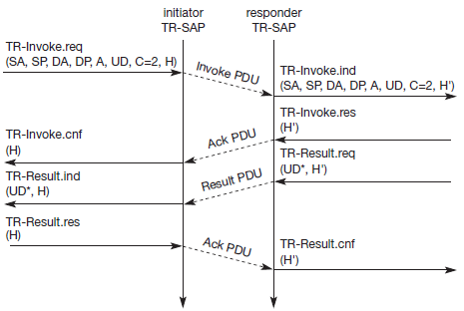
Wireless transaction protocol (Contd…) Class 2
An even more reliable service can be provided by user acknowledgement
The time-sequence diagram looks different
The user on the responder’s side now explicitly responds to the Invoke PDU using the TR-Invoke.res primitive, which triggers the TR-Invoke.cnf on the initiator’s side via an ack PDU.
The transmission of the result is also a confirmed service, as indicated by the next four service primitives.
Basic transaction,
WTP class 2, with user
acknowledgement

Slide 53
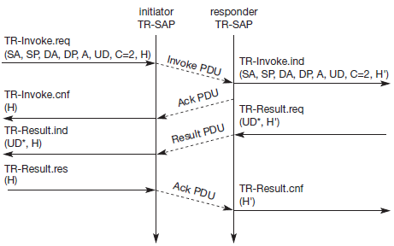
Wireless transaction protocol (Contd…) Class 2
If the calculation of the result takes some time, the responder can put the initiator on “hold on” to prevent a retransmission of the invoke PDU
After a time-out, the responder automatically generates an acknowledgement for the Invoke PDU.
After more time, the result PDU can be sent to the initiator as already explained.
WTP class 2 transaction
with “hold on”, no user
acknowledgement

Slide 54
Wireless Session Protocol

Slide 55
Wireless session protocol
The wireless session protocol (WSP) has been designed to operate on top of the datagram service WDP or the transaction service WTP
WSP offers features needed for content exchange between cooperating clients and servers:
Session management:
WSP introduces sessions that can be established from a client to a server and may be long lived.
Sessions can also be released in an orderly manner.
The capabilities of suspending and resuming a session are important to mobile applications.
Assume a mobile device is being switched off – it would be useful for a user to be able to continue operation at exactly the point where the device was switched off.
Session lifetime is independent of transport connection lifetime or continuous operation of a bearer network

Slide 56
Wireless session protocol (Contd…)
Capability negotiation
Clients and servers can agree upon a common level of protocol functionality during session establishment.
Example parameters to negotiate are maximum client SDU size, maximum outstanding requests, protocol options, and server SDU size.
Content encoding
WSP also defines the efficient binary encoding for the content it transfers.
WSP offers content typing and composite objects, as explained for web browsing.

Slide 57
Wireless session protocol (Contd…)
While WSP is a general-purpose session protocol, WAP has specified the wireless session protocol/browsing (WSP/B) which comprises protocols and services most suited for browsing-type applications.
In addition to the general features of WSP, WSP/B offers the following features adapted to web browsing:
HTTP/1.1 functionality:
WSP/B supports the functions HTTP/1.1 offers, such as extensible request/reply methods, composite objects, and content type negotiation. WSP/B is a binary form of HTTP/1.1.
HTTP/1.1 content headers are used to define content type, character set encoding, languages etc., but binary encodings are defined for well-known headers to reduce protocol overheads.
Exchange of session headers
Client and server can exchange request/reply headers that remain constant over the lifetime of the session.
These headers may include content types, character sets, languages, device capabilities, and other static parameters.
WSP/B will not interpret header information but passes all headers directly to service users.

Slide 58
Wireless session protocol (Contd…)
Push and pull data transfer
Pulling data from a server is the traditional mechanism of the web. This is also supported by WSP/B using the request/response mechanism from HTTP/1.1.
Additionally, WSP/B supports three push mechanisms for data transfer: a confirmed data push within an existing session context, a non-confirmed data push within an existing session context, and a non-confirmed data push without an existing session context.
Asynchronous requests
Optionally, WSP/B supports a client that can send multiple requests to a server simultaneously.
This improves efficiency for the requests and replies can now be coalesced into fewer messages.
Latency is also improved, as each result can be sent to the client as soon as it is available.

Slide 59
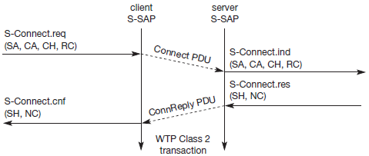
Wireless session protocol (Contd…) WSP/B over WTP
WSP/B uses the three service classes of WTP
Class 0 is used for unconfirmed push, session resume, and session management.
Confirmed push uses class 1, method invocation, session resume, and session management class 2.
The following time sequence charts will give some examples.
Session establishment of WSP/B using WTP class 2 transactions.
WSP/B session
establishment

Slide 60
Wireless session protocol (Contd…) WSP/B over WTP
With the S-Connect.req primitive, a client can request a new session.
Parameters are the server address (SA), the client address (CA), and the optional client header (CH) and requested capabilities (RC).
The session layer directly uses the addressing scheme of the layer below.
TR-SAP and S-SAP can be directly mapped.
A client header can comprise user-to-user information compatible with HTTP message headers. These headers can be used, throughout the session.
Interpretation is up to the user of this service.
WTP transfers the connect PDU to the server S-SAP where an S-Connect.ind primitive indicates a new session. Parameters are the same, but now the capabilities are mandatory.
If the server accepts the new session it answers with an S-Connect.res, parameters are an optional server header (SH) with the same function as the client header and the negotiated capabilities (NC) needed for capability negotiation.
WTP now transfers the connreply PDU back to the client; S-Connect.cnf confirms the session establishment and includes the server header (if present) and the negotiated capabilities from the server.
WSP/B includes several procedures to refuse a session or to abort session establishment.

Slide 61
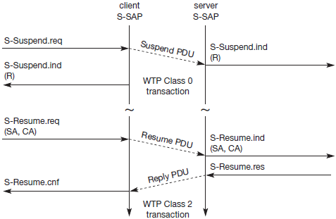
Wireless session protocol (Contd…) WSP/B over WTP
A very useful feature of WSP/B session suspension and session resume is shown in Figure
If, for example, a client notices that it will soon be unavailable, e.g., the bearer network will be unavailable due to roaming to another network or the user switches off the device, the client can suspend the session.
Session suspension will automatically abort all data transmission and freeze the current state of the session on the client and server side.
WSP/B session
suspension and resume

Slide 62
Wireless session protocol (Contd…) WSP/B over WTP
A client suspends a session with S-Suspend.req, WTP transfers the suspend PDU to the server with a class 0 transaction, i.e., unconfirmed and unreliable.
WSP/B will signal the suspension with S-Suspend.ind on the client and server side
The only parameter is the reason R for suspension. Reasons can be a user request or a suspension initiated by the service provider.
A client can later resume a suspended session with S-Resume.req. Parameters are server address (SA) and client address (CA).
If SA and CA are not the same as before suspending this session, it is the responsibility of the service user to map the addresses accordingly so that the same server instance will be contacted. Resuming a session is a confirmed operation.
It is up to the server’s operator how long this state is conserved.

Slide 63
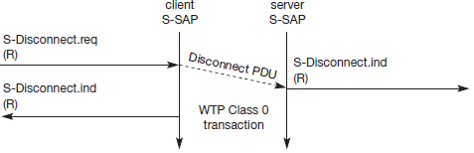
Wireless session protocol (Contd…) WSP/B over WTP
Terminating a session is done by using the S-Disconnect.req service primitive
This primitive aborts all current method or push transactions used to transfer data.
Disconnection is indicated on both sides using S-Disconnect.ind.
The reason R for disconnection can be, e.g., network error, protocol error, peer request, congestion, and maximum SDU size exceeded.
S-Disconnect.ind can also include parameters that redirect the session to another server where the session may continue.
WSP/B session
termination

Slide 64
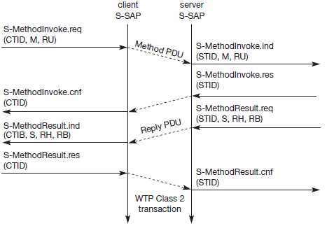
Wireless session protocol (Contd…) WSP/B over WTP
The S-MethodInvoke primitive is used to request that an operation is executed by the server. The result, if any, is sent back using the S-MethodResult primitive
A client requests an operation with S-MethodInvoke.req.

Slide 65
Wireless session protocol (Contd…) WSP/B as connectionless session service
There are cases where the overhead of session establishment and release, confirmed method invocation and all associated states is simply too much and a high degree of reliability is not required.
In these cases, It is possible to runWSP/B on top of the connectionless, unreliable WDP service.
Figure shows the three service primitives available for connectionless session service:
S-Unit-MethodInvoke.req to request an operation on a server,
S-Unit-MethodResult.req to return results to a client, and
S-Unit-Push.req to push data onto a client.
Transfer of the PDUs (method, reply and push) is done with the help of the standard unreliable datagram transfer service of WDP.

Slide 66
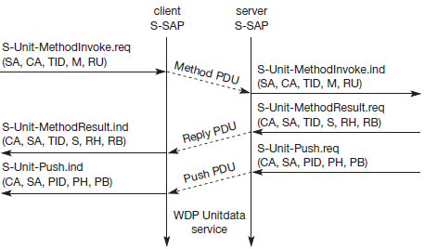
Wireless session protocol (Contd…) WSP/B as connectionless session service
Besides the server address (SA), the client address (CA), the method (M), and the request URI (RU),
S-Unit-MethodInvoke.req primitive can determine a transaction identifier (TID) to distinguish between different transactions on the user level.
TID is communicated transparently from service user to service user.
WSP/B as
connectionless
session service

Slide 67
Wireless session protocol (Contd…) WSP/B as connectionless session service
The function of the S-Unit-MethodResult primitive remains the same as above: the status (S), response header (RH), and response body (RB) represent the result of the operation.
The S-Unit-Push primitive has the parameters client address (CA), server address (SA), push identifier (PID), push header (PH), and push body (PB).

Slide 68
Wireless Application Environment

Slide 69
Wireless application environment
The main idea behind the wireless application environment (WAE) is to create a general-purpose application environment based mainly on existing technologies and philosophies of the world wide web
This environment should allow service providers, software manufacturers, or hardware vendors to integrate their applications so they can reach a wide variety of different wireless platforms in an efficient way
WAE has already integrated the following technologies and adapted them for use in a wireless environment
HTML, JavaScript and the handheld device markup language HDML form the basis of the wireless markup language (WML) and the scripting language WMLscript.

Slide 70
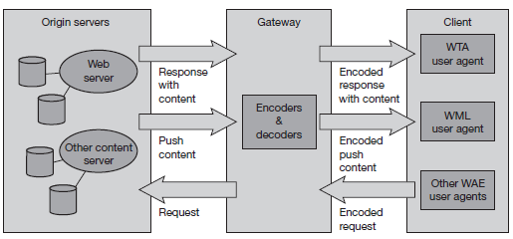
Wireless application environment (Contd…)
WAE focuses on devices with very limited capabilities, narrow-band environments, and special security and access control features. The first phase of the WAE specification developed a whole application suite
Future developments for the WAE will include extensions for more content formats, integration of further existing or emerging technologies, more server-side aspects, and the integration of intelligent telephone networks.
WAE logical
model

Slide 71
Wireless application environment (Contd…)
One global goal of the WAE is to minimize over-the-air traffic and resource consumption on the handheld device.
This goal is also reflected in the logical model underlying WAE
WAE adopts a model that closely follows the www model, but assumes additional gateways that can enhance transmission efficiency.
A client issues an encoded request for an operation on a remote server.
Encoding is necessary to minimize data sent over the air and to save resources on the handheld device as explained together with the languages WML and WMLscript.
Decoders in a gateway now translate this encoded request into a standard request as understood by the origin servers.

Slide 72
Wireless application environment (Contd…)
Several user agents can reside within a client.
User agents include such items as: browsers, phonebooks, message editors etc.
WML user agent that supports WML, WMLscript, or both
WTA user agent handles access to, and interaction with, mobile telephone features
Further domain-specific user agents with varying architectures can be implemented. Again, this is left to vendors.

Slide 73
Wireless Markup Language

Slide 74
Wireless markup language
The wireless markup language (WML) is based on the standard HTML
WML is specified as an XML document type.
WML follows a deck and card metaphor.
A WML document is made up of multiple cards.
Cards can be grouped together into a deck
A WML deck is similar to an HTML page, in that it is identified by a URL and is the unit of content transmission.
A user navigates with the WML browser through a series of WML cards, reviews the contents, enters requested data, makes choices etc.
The WML browser fetches decks as required from origin servers.
Either these decks can be static files on the server or they can be dynamically generated

Slide 75
Wireless markup language (Contd…)
WML includes several basic features:
Text and images:
WML gives hints how text and images can be presented to a user.
WML only provides a set of mark-up elements, such as emphasis elements (bold, italic, etc.) for text, or tab columns for tabbing alignment.
User interaction:
WML supports different elements for user input.
Examples are: text entry controls for text or password entry, option selections or controls for task invocation.
Navigation:
As with HTML browsers, WML offers a history mechanism with navigation through the browsing history,
Context management:
WML allows for saving the state between different decks without server interaction, i.e., variable state can last longer than a single deck, and so state can be shared across different decks.
Cards can have parameters defined by using this state without access to the server over the narrow-band wireless channel.

Slide 76
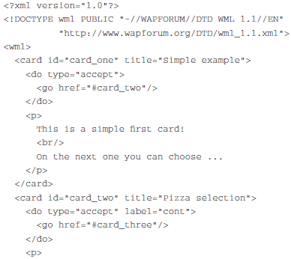
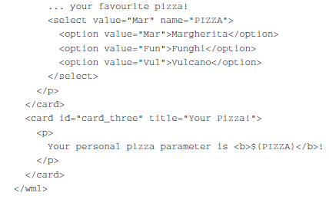
WML Example

Slide 77
Wireless markup language (Contd…)
First, a reference to XML is given where WML was derived from.
Then, after the keyword wml the first card is defined.
This first card of the deck “displays” a text after loading (“displaying” could also mean voice output etc.).
As soon as a user activates the do element (a button or voice command), the user agent displays the second card.
On this second card, the user can select one out of three pizza options.
Depending on the choice of the user, PIZZA can have one of the values Mar, Fun, or Vul.
If the user proceeds to the third card without choosing a pizza, the value Mar is used as default.
Again, describing these options with WML does not automatically mean that these options are displayed as text.
It could also be possible that the user agent reads the options through a voice output and the user answers through a voice input.
WML only describes the intention of a choice.
The third card finally outputs the value of PIZZA.

Slide 78
WMLScript
WMLScript complements to WML and provides a general scripting capability in the WAP architecture
While all WML content is static (after loading on the client), WMLScript offers several capabilities not supported by WML:
Validity check of user input
before user input is sent to a server, WMLScript can check the validity and save bandwidth and latency in case of an error.
Otherwise, the server has to perform all the checks, which always includes at least one round-trip if problems occur.
Access to device facilities
WMLScript offers functions to access hardware components and software functions of the device.
On a phone a user could, e.g., make a phone call, access the address book, or send a message via the message service of the mobile phone.

Slide 79
WML Script

Slide 80
WMLScript (Contd…)
Local user interaction
Without introducing round-trip delays, WMLScript can directly and locally interact with a user, show messages or prompt for input.
Only, for example, the result of several interactions could be transmitted to a server.
Extensions to the device software
With the help of WMLScript a device can be configured and new functionality can be added even after deployment.
Users can download new software from vendors and, thus, upgrade their device easily.

Slide 81
WMLScript (Contd…)
WMLScript is based on JavaScript but adapted to the wireless
environment.
This includes a small memory footprint of the simple WMLScript bytecode interpreter and an efficient over-the-air transport via a space efficient bytecode.
A WMLScript compiler is used to generate this bytecode.
This compiler may be located in a gateway or the origin servers store pre-compiled WMLScript bytecode.
WMLScript is event-based, i.e., a script may be invoked in response to certain user or environment events.
WMLScript also has full access to the state model of WML, i.e., WMLScript can set and read WML variables.

Slide 82
WMLScript (Contd…)
WMLScript provides many features known from standard programming languages such as functions, expressions, or while, if, for, return etc. statements.
The language is weakly-typed, i.e., any variable can contain any type (such as integer, float, string, boolean) – no explicit typing is necessary.
WMLScript provides an automatic conversion between different types if possible.
Parameters are always passed by value to functions.

Slide 83
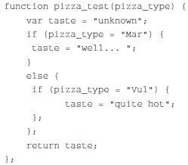
WMLScript (Contd…)
Here is a simple example for some lines of WMLScript: the function pizza_test accepts one value as input. The local variable taste is initialized to the string "unknown".
Then the script checks if the input parameter pizza_type has the value "Mar".
If this is the case, taste is set to "well... ", otherwise the script checks if the pizza_type is "Vul".
If this is the case, taste is set to "quite hot".
Finally, the current value of taste is returned as the value of the function pizza_test.

Slide 84
WMLScript (Contd…)
The WMLScript compiler can compile one or more such scripts into a WMLScript compilation unit.
A handheld wireless device can now fetch such a compilation unit using standard protocols with HTTP semantics, such as WSP
Within a compilation unit, a user can call a particular function using standard URLs with a fragment anchor.
A fragment anchor is specified by the URL, a hash mark (#), and a fragment identifier.

Slide 85
WMLScript (Contd…)
The following six libraries have been defined
Lang:
This library provides functions closely related to WMLScipt itself
Examples are is Int to check if a value could be converted into an integer or float to check if floating-point operations are supported.
Float
Many typical arithmetic floating-point operations are in this library (which is optional as mentioned before).
Example functions are round for rounding a number and sqrt for calculating the square root of a given value.
String
Many string manipulation functions are in this library
Examples are well-known functions such as length to return the length of a string or subString to return a substring of a given string.
Nevertheless, this library also provides more advanced functions such as find to find a substring within a string or squeeze to replace several consecutive whitespaces with only one.

Slide 86
WMLScript (Contd…)
URL:
This library provides many functions for handling URLs with the syntax defined in Fielding (1995):
<scheme>://<host>:<port>/<path>;<parameters>?<query>#<fragment>
for example: http://www.xyz.int:8080/mypages;5;2?j=2&p=1#crd. The function getPath could now extract the path of this URL, i.e., "mypages", getQuery has the query part "j=2&p=1" as return value, and getFragment delivers the fragment used in the URL, i.e., "crd".
WMLBrowser
This library provides several functions typical for a browser, such as prev to go back one card or refresh to update the context of the user interface. The function go loads the content provided as parameters:
var my_card = "http://www.xyz.int/pizzamatic/apps.dck#start";
var my_vars = "j=4&k=7";
WMLBrowser.go(my_card, my_vars);
Dialogs
For interaction with a user, this library has been defined.
An example function is prompt which displays a given message and prompts for user input.

